Slide 1
Ruby's Enumerable module
David Grayson
Las Vegas Ruby Group
2012-03-21

Slide 2
Enumerable should be familiar!
Included by Array, Hash, Range, Set, String#chars, String#bytes, maybe ActiveRecord::Relation
object.is_a? Enumerable

Slide 3
What is an Enumerable?
Represents a series of objects.
Can be lazily generated.
Can be infinite.

Slide 4
Enumerable provides methods:
#all?
#any?
#chunk
#collect
#collect_concat
#count
#cycle
#detect
#drop
#drop_while
#each_cons
#each_entry
#each_slice
#each_with_index
#each_with_object
#entries
#find
#find_all
#find_index
#first
#flat_map
#grep
#group_by
#include?
#inject
#map
#max
#max_by
#member?
#min
#min_by
#minmax
#minmax_by
#none?
#one?
#partition
#reduce
#reject
#reverse_each
#select
#slice_before
#sort
#sort_by
#take
#take_while
#to_a
#zip

Slide 5
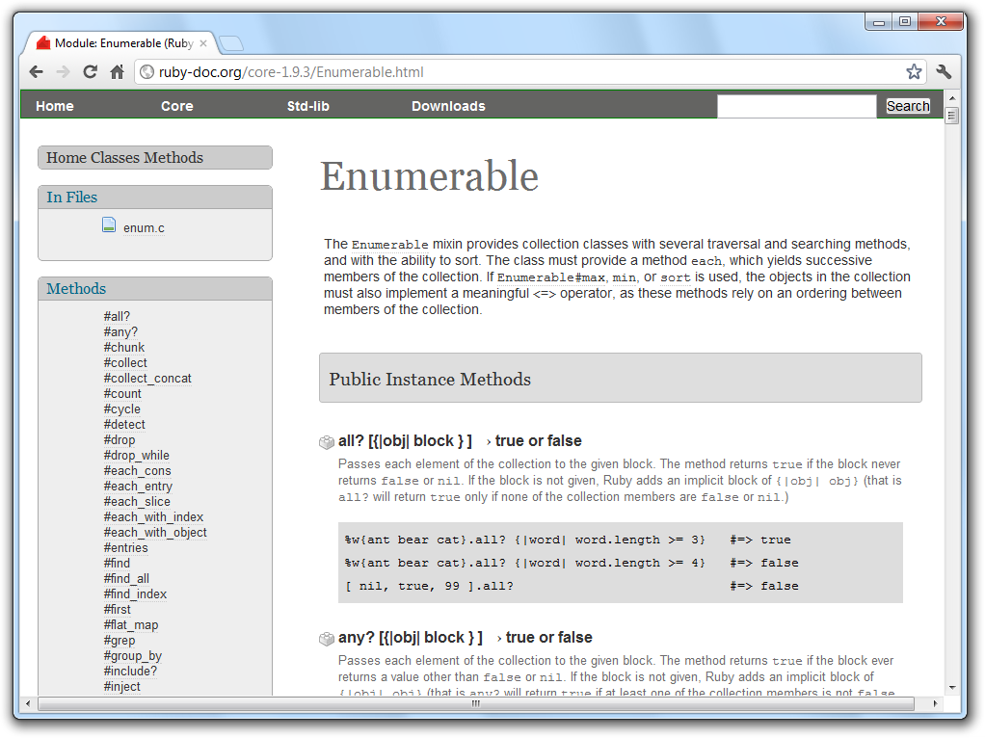

Slide 6
How to make an Enumerable
Easy way: just make an Array
Need to know all values ahead of time.
Arrays can't be infinite!

Slide 7
How to make an Enumerable
class HouseCollection
include Enumerable
def each
yield house
# ... insert complex code
yield house
end
end
enum = HouseCollection.new

Slide 8
How to make an Enumerable
class HouseCollection
# class writer forgot to include Enumerable
def each
yield house
# ... insert complex code
yield house
end
end
enum = HouseCollection.new.to_enum

Slide 9
How to make an Enumerable
class HouseCollection
# class writer forgot to include Enumerable
def each_house
yield house
# ... insert complex code
yield house
end
end
enum = HouseCollection.new.to_enum(:each_house)

Slide 10
How to make an Enumerable
enum = Enumerator.new do |y|
y << 1
y << 10
y << 6
end
Enumerable is a module
Enumerator is a class that includes Enumerable.

Slide 11
Example Uses of
Enumerables

Slide 12
Basic use
enum = "a".."f"
enum.to_a # => ["a", "b", "c", "d", "e", "f"]
enum.entries # => ["a", "b", "c", "d", "e", "f"]
enum.count # => 6
enum.count("b") # => 1
enum.count { |s| s <= "c" } # => 3

Slide 13
Iteration
enum = 1..6
enum.each { |x| ... }
enum.each_entry { |x| ... }
# yields 1, 2, 3, 4, 5, 6
enum.each_cons(2) { |x, next_x| ... }
# yields [1,2], [2,3], [3,4] ...
enum.each_slice(3) { |x0, x1, x2| ... }
# yields [1,2,3], [4,5,6]
enum.each_with_index { |x, index| ... }
# yields [1, 0], [2, 1], [3, 2] ...
enum.reverse_each { |x| ... }
# yields 6, 5, 4, 3, 2, 1

Slide 14
Iteration with #cycle
players = ["alex", "bob", "caterina",
"david", "errol", "fred"]
players.cycle { |player| ... }
# Equivalent to:
while true
players.each do |player|
...
end
end
# Can also specify number of cycles:
players.cycle(3) { |player| ... }

Slide 15
Iteration with Enumerator
enumerable = 1..3
enumerator = enumerable.to_enum
p enumerator.next # => 1
p enumerator.next # => 2
p enumerator.next # => 3
p enumerator.next # => StopIteration exception
Enumerable is a module
Enumerator is a class that includes Enumerable.

Slide 16
Asking questions
enum = [2, 5, 7, 10]
enum.include?(5) # => true
enum.member?(5) # => true
enum.all? { |x| x < 11 } # => true
enum.none? { |x| x > 11 } # => true
enum.any? { |x| x > 6 } # => true
enum.one? { |x| x.even? } # => false

Slide 17
Sorting
enum = [6, -1, 3, -4]
enum.sort # => [-4, -1, 3, 6]
enum.min # => -4
enum.max # => 6
enum.minmax # => [-4, 6]

Slide 18
Advanced sorting
enum = [6, -1, 3, -4]
enum.sort_by &:abs # => [-1, 3, -4, 6]
enum.sort_by { |x| x%10 } # => [3, 6, -4, -1]
#min_by, #max_by, and
#minmax_by also available!

Slide 19
(Almost Always) too advanced sorting
countries.sort { |c1,c2| c1.code <=> c2.code}
countries.sort_by :&code
friends.sort { |a, b| arm_wrestle(a, b) }
#min, #max, and #minmax
can also take a block

Slide 20
Searching for one element
names = ["judd", "russ", "david", "paul", "ryan"]
names.find { |n| n[1] == "a" } # => "david"
names.detect { |n| n[1] == "a" } # => "david"
names.find_index { |n| n[1] == "a" } # => 2
names.find_index("david") # => 2

Slide 21
Filtering by value
names = ["judd", "russ", "david", "paul", "ryan"]
names.select { |n| n[1] == "u" }
# => ["judd", "russ"]
names.reject { |n| n.length < 5 }
# => ["david"]
names.grep(/u/)
# => ["judd", "russ", "paul"]
[1, 4.0, nil, Object, 5].grep(Integer)
# => [1,5]

Slide 22
Filtering by position in series
days = ["mon", "tue", "wed",
"thu", "fri", "sat", "sun"]
p days.first # => "mon"
p days.first(2) # => ["mon", "tue"]
p days.drop(5) # => ["sat", "sun"]
p days.drop_while { |x| x != "sat" }
# => ["sat", "sun"]
p days.take(2) # => ["mon", "tue"]
p days.take_while { |x| x != "wed" }
# => ["mon", "tue"]

Slide 23
Dividing into subsets: chunk
hand = ["7H", "AS", "KS", "JS", "9H"]
p hand.chunk{|c| c[1]}.each { |suit, cards| }
# yields "H", ["7H"]
# "S", ["AS, "KS", JS"]
# "H", ["9H"]
Order matters; chunks are consecutive

Slide 24
Dividing into subsets: group_by
Order does not matter!
hand = ["7H", "AS", "KS", "JS", "9H"]
hand.group_by { |c| c[1] }
# => {
# "H"=>["7H", "9H"],
# "S"=>["AS", "KS", "JS"]
# }

Slide 25
Dividing into subsets: partition
players = ["alex", "bob", "caterina",
"david", "errol", "fred"]
teams = players.partition { |p| players.index(p).even? }
# => [ ["alex", "caterina", "errol"],
# ["box", "david", "fred"] ]
# Cooler way:
teams = players.partition.with_index do |p, index|
index.even?
end

Slide 26
Dividing into subsets: slice_before
Block returns “true” => start of new chunk
(3..11).slice_before{ |n| n%5 == 0}.each{ |s| ... }
# yields [3, 4]
# [5, 6, 7, 8, 9],
# [10, 11]

Slide 27
inject (a.k.a. reduce)
Combines all the elements together.
enum = 1..4
enum.inject(:+) # 1+2+3+4 => 10
enum.inject(0.5, :*) # 0.5*1*2*3*4 => 12.0
enum.inject { |memo, x| ... }
enum.inject(initial) { |memo, x| ... }
enum.each_with_object(memo) { |x, memo| ... }

Slide 28
zip
zips 2 or more enums together into one
team1.zip(team2) do |player1, player2|
play_chess player1, player2
end

Slide 29
map and flat_map
require 'set'
names = Set.new ["richard hoppes"
"nicholas shook"]
p names.map &:upcase
# => ["RICHARD HOPPES", "NICHOLAS SHOOK"]
p names.map &:split
# => [["richard", "hoppes"], ["nicholas", "shook"]]
p names.flat_map &:split
# => ["richard", "hoppes", "nicholas", "shook"]
Alternate names: #collect, #collect_concat

Slide 30
Another flat_map example
entrants = { :jason => 2, :jeremy => 3 }
entrants.flat_map { |k, v| [k] * v }
# => [:jason, :jason, :jeremy, :jeremy, :jeremy]

Slide 31
Ruby 2.0: Enumerable::Lazy
In 1.9, lots of enumerable functions return arrays => can't be lazy
In 2.0:
a = [1,2,3,4,2,5].lazy.map { |x| x * 10 }.
select { |x| x > 30 } # => no evaluation
a.to_a # => [40, 50]
http://blog.railsware.com/2012/03/13/ruby-2-0-enumerablelazy/

Slide 32
Fibbonacci enumerator
def fibbonacci(a=0, b=1)
return enum_for(:fibbonacci,a,b) if !block_given?
yield a
yield b
while true
a, b = b, a + b
yield b
end
end
fibbonacci.first(10)
# => [0, 1, 1, 2, 3, 5, 8, 13, 21, 34]
fibbonacci.each_cons(2) { |x, y| puts y.to_f/x }
# => approaches Golden Ratio, 1.61803399

Slide 33
The End

Slide 34

Taboo game
0
1
1
0
0
1

Slide 35
Taboo: take turns
while true
players.each do |player|
# ...
end
end
players.cycle do |player|
# ...
end
players.cycle(3) do |player|
# ...
end

Slide 36
Taboo: scoring turns
def turn_score(player, goal_word, taboo_words)
return -1 if words_said_by(player).any? do |word|
taboo_words.include?(word)
end
guessed_words = @players.flat_map do |player|
words_said_by(player)
end
return 1 if guessed_words.member?(goal_word)
return 0
end
-1 if the player said any of the taboo_words!
+1 if any other players said the goal_word
Otherwise, 0
#all?, #none?, and #one? also available!

Slide 37
Taboo: winners
teams = [team0, team1]
winning_team = teams.max_by &:score
losing_team = teams.min_by &:score
losing_team, winning_team = teams.minmax_by &:score
losing_team, winning_team = teams.sort_by &:score

Slide 38
Linked List Example
class Node
attr_accessor :value, :next_node
def initialize(value)
@value = value
end
end

Slide 39
Linked List Example
class LinkedList
include Enumerable
attr_accessor :next_node # first node of list
def each
n = self
while n = n.next_node
yield n.value
end
end
def initialize(values)
values.inject(self) do |last_node, value|
last_node.next_node = Node.new(value)
end
end
end

Slide 40
Linked List Example
list = LinkedList.new(1..7)
p list.count # => 7
p list.to_a # => [1, 2, 3, 4, 5, 6, 7]
p list.entries # same as #to_a
p list.inject(:+) # => 28

Slide 41
Fibbonacci: each_with_index
fibbonacci.each_with_index do |f, index|
puts "#{index}: #{f}"
break if f > 10
end
Output:
0: 0
1: 1
2: 1
3: 2
4: 3
5: 5
6: 8
7: 13

Slide 42
Fibonacci: each_cons
fibbonacci.each_cons(2) do |x, y|
puts "%10f %2d %2d" % [y.to_f/x, x, y]
end
Output:
Inf 1 0
1.000000 1 1
2.000000 2 1
1.500000 3 2
1.666667 5 3
1.600000 8 5
1.625000 13 8
1.615385 21 13
1.619048 34 21
1.617647 55 34
...

